Slide 1
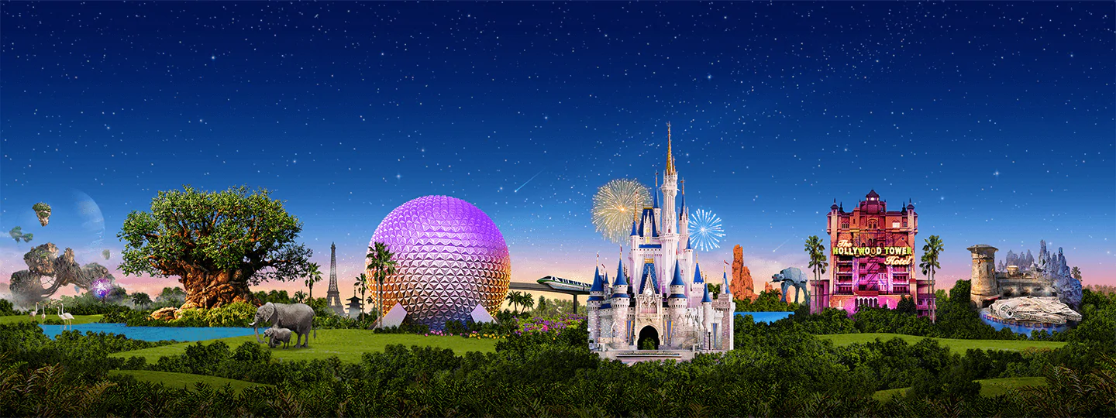

Virtual Disney Trip
Primary 5 - 7

Slide 2
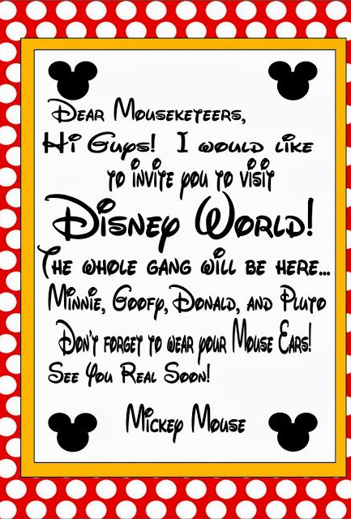
Monday: Day 1
Prepare your passport
Plan your timings
Check the weather

Slide 3
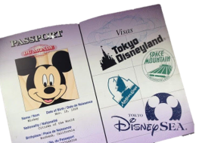

Art
Create a passport that you can use during your trip!
Remember to include:
A front cover
Your name
A picture of yourself
Lots of space for characters names!
Each time you see a character this week in a ride, video or song, make sure to write their name in your passport! How many characters will you meet by the end of the week?

Slide 4
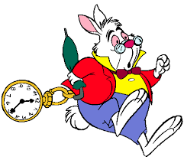
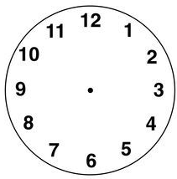
Numeracy: What time?
Draw the hour and minute hands to show the time.
The park opens at quarter past 9.
You visit Mickey’s house at 11 o’clock.
You go on the log flumes at half past 1.
Challenge!
You visit the arcade at 10 past 4.
You eat dinner at 6:15pm.
The park closes at 25 minutes past 8.

Slide 5

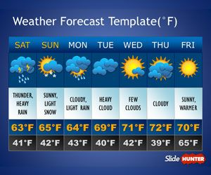
Weather Check
Disneyland is in Orlando in America.
Find out what the weather is like in Orlando this week.
Will it be rainy, cloudy or sunny?
What is the temperature?
Task: Create a weather report video/poster or something else to tell us about the weather at Disney World.
What will we need to pack to be prepared?

Slide 6
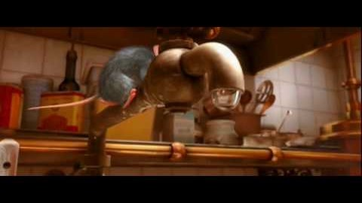
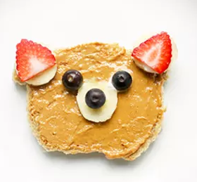
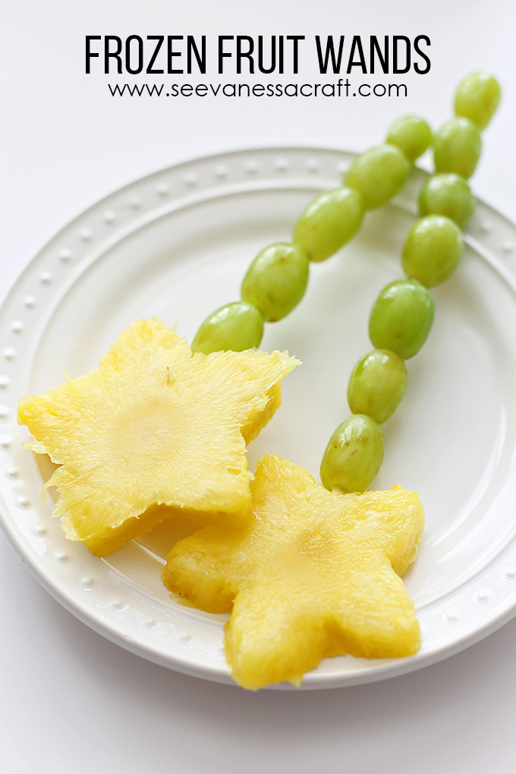
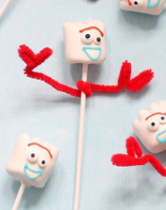
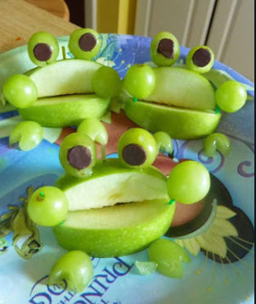
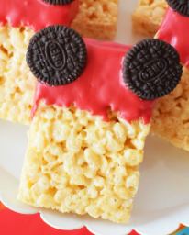
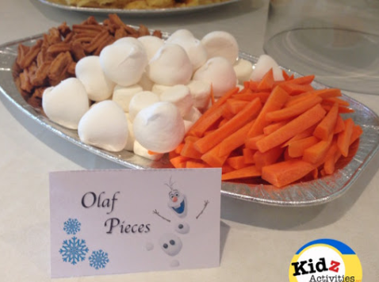
Snack Time
Some simple snack ideas
Can you help to prepare a healthy snack today? Follow a recipe if you can!
Take a photo and show us your home made snacks!

Slide 7
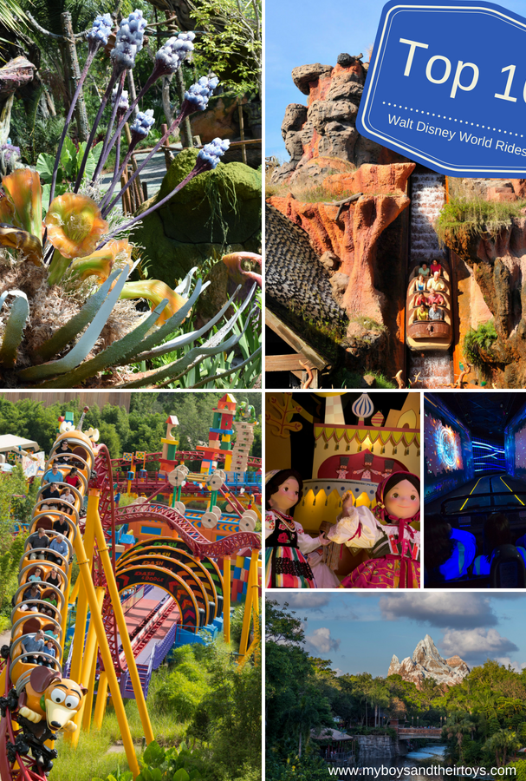
Tuesday: Day 2
It’s time to explore the rides!

Slide 8
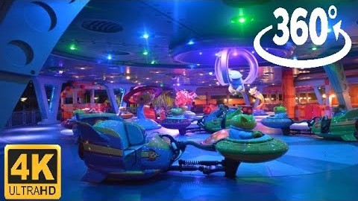
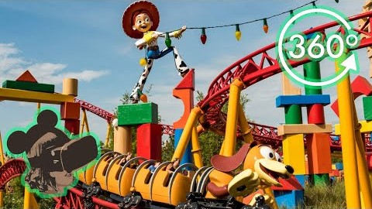
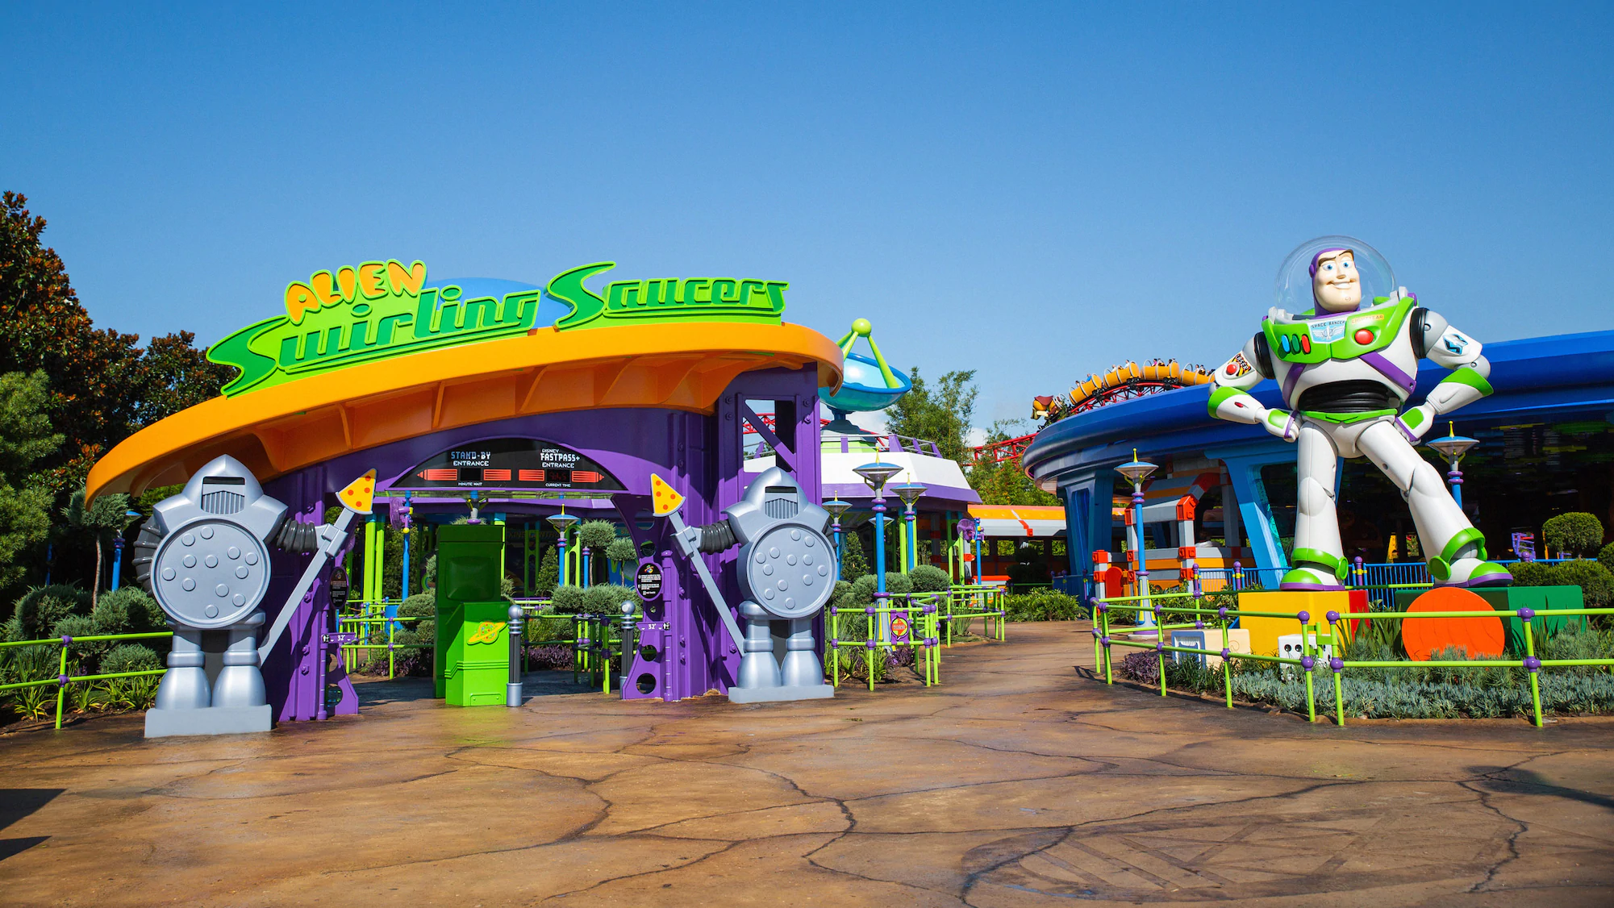
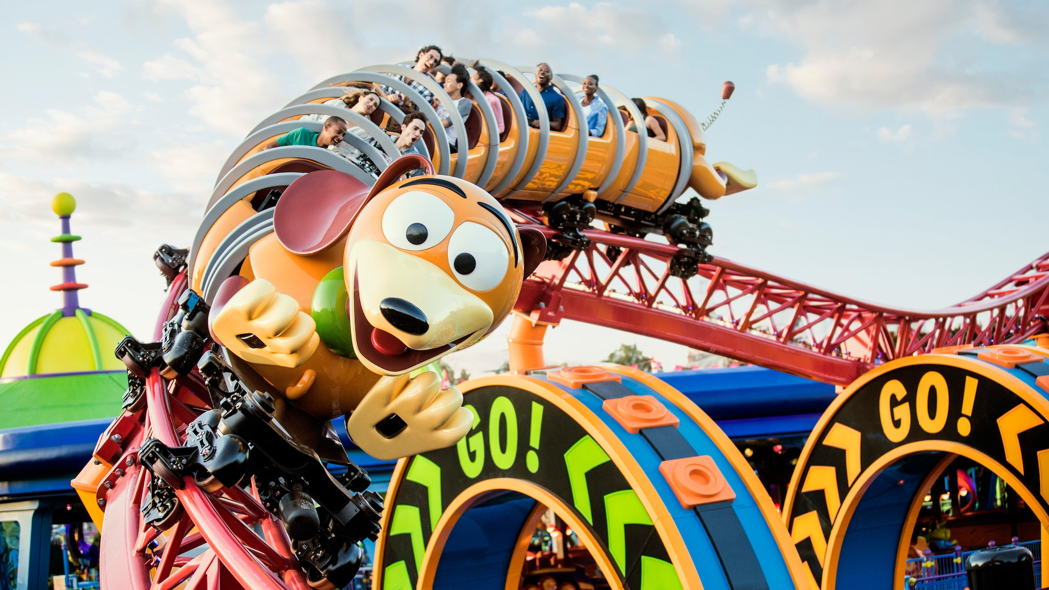
Numeracy: Let’s Ride!
Alien Swirling Saucers: 81cm or taller.
Estimate your height in centimetres (cm).
Measure your height. Are you able to ride?
If yes: By how much?
If not: How much taller would you need to be?
Slinky Dog Dash: 97cm or taller.
Estimate a family member’s height. Are they able to ride?
Measure their height. Are they able to ride?
If yes: By how much?
If not: How much taller would they need to be?
Ready to ride? Click the rides to go!

Slide 9
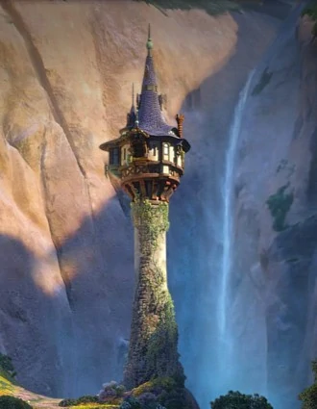
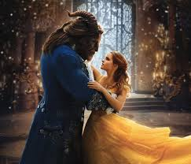
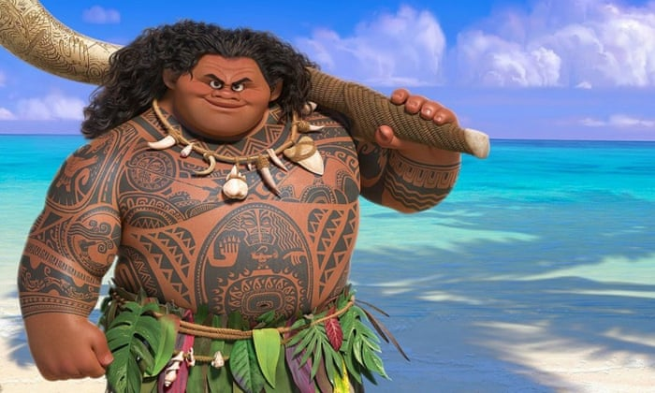
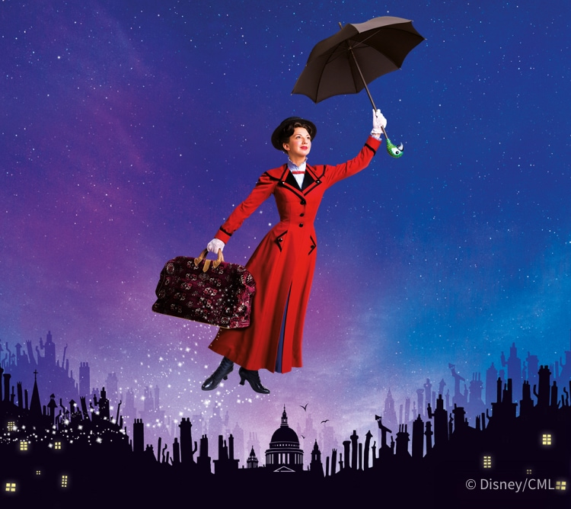
Reading & Writing – Uplevel these sentences
1. The hook is behind his back.
2. The tower stands tall in the mountains.
3. The lady flies high in the sky using her umbrella.
4. The beautiful lady falls in love with the ugly beast. They dance together.

Slide 10
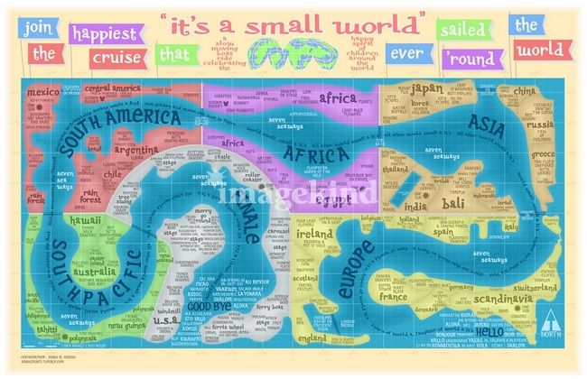
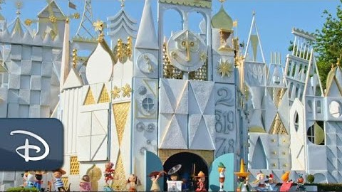

It’s a Small World
3. Compare Scotland to another country.
You may include:
Location
Weather
Food
Flags
Attractions/scenery
Anything else!
You can create a poster or record a video to showcase your information.
1. Set sail on the, ‘It’s a Small World’ Boat Ride to visit countries around the world. (Click the picture to go!)
2. Find out the names of the 7 different continents in the world.

Slide 11
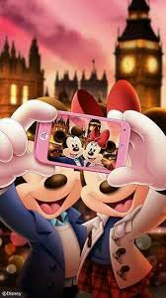


Wednesday: Day 3
Frozen Ever After
Selfies
Lunch time
Under the Sea

Slide 12

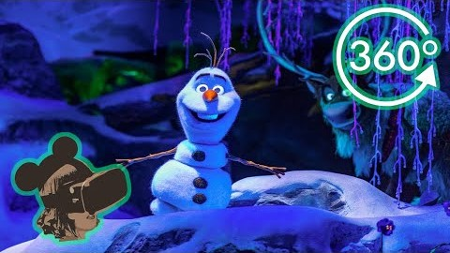
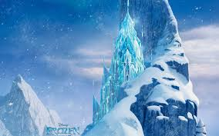
Frozen Ever After
1. Ride on the ‘Frozen Ever After’ Ride.
2. Think of 6 words that rhyme with snow.
3. Use all these words to write a silly story.

Slide 13
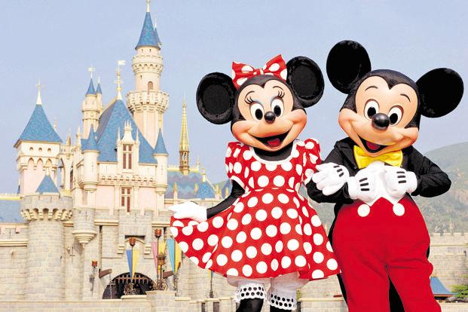
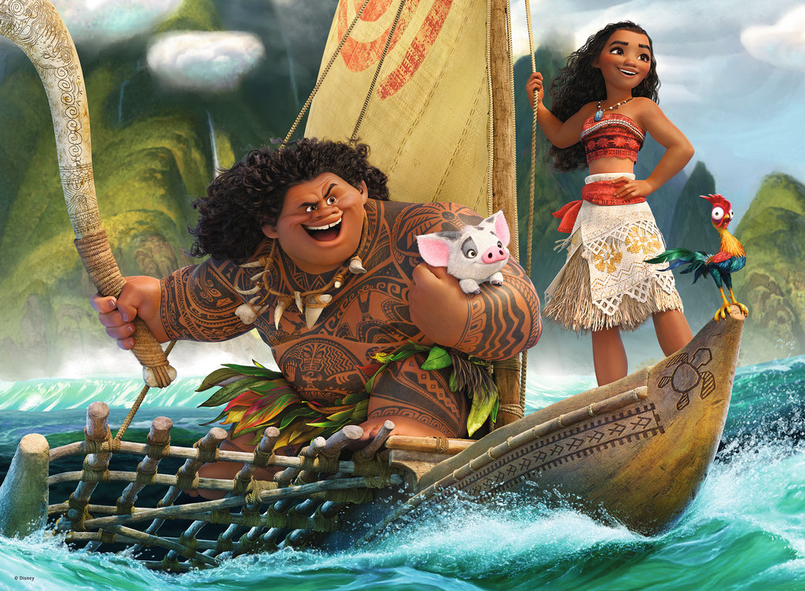
Take a Selfie
Add a photo of your face to the pictures to create your own Disney selfie.

Slide 14
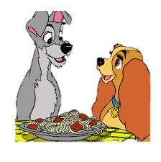
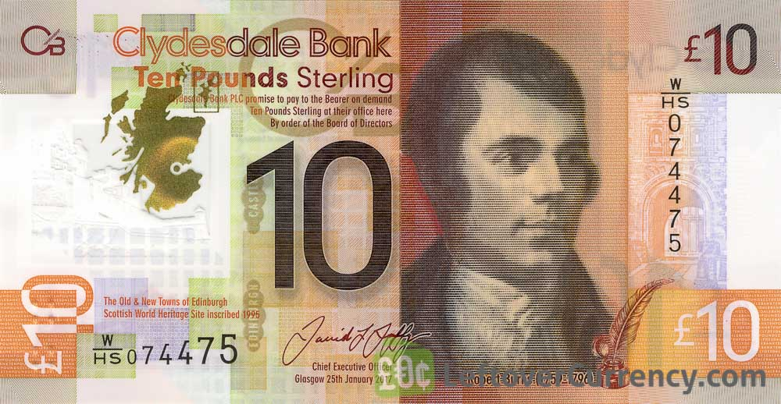
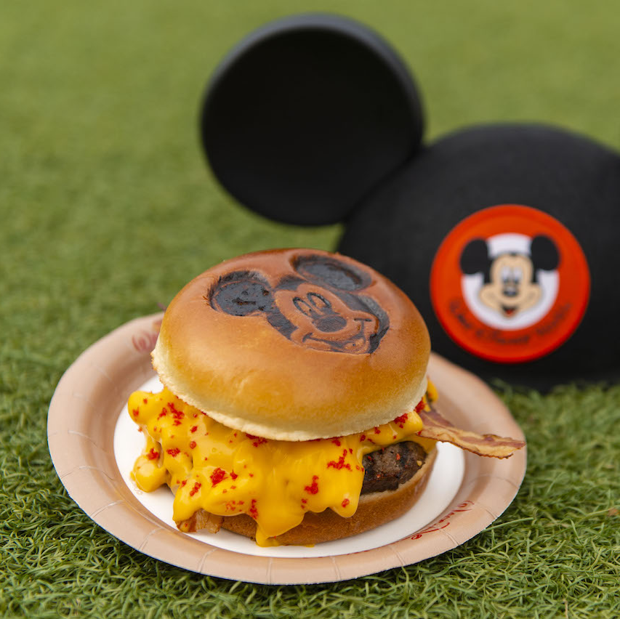
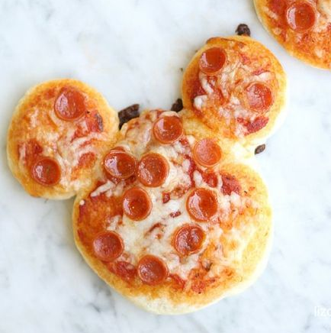
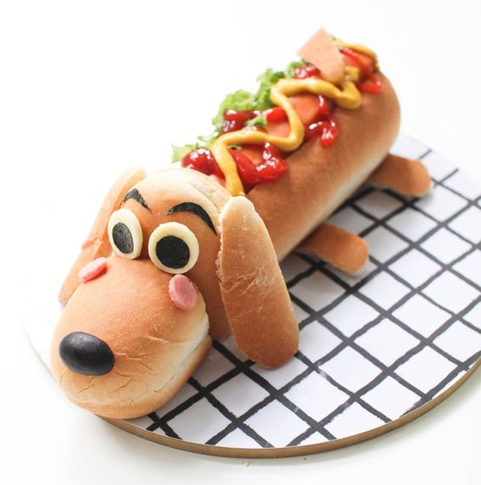
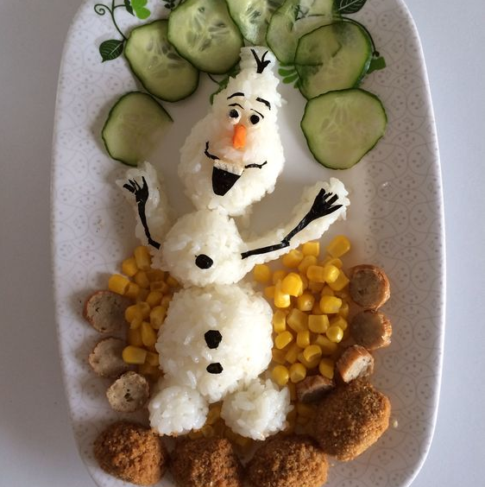
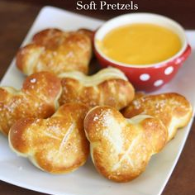
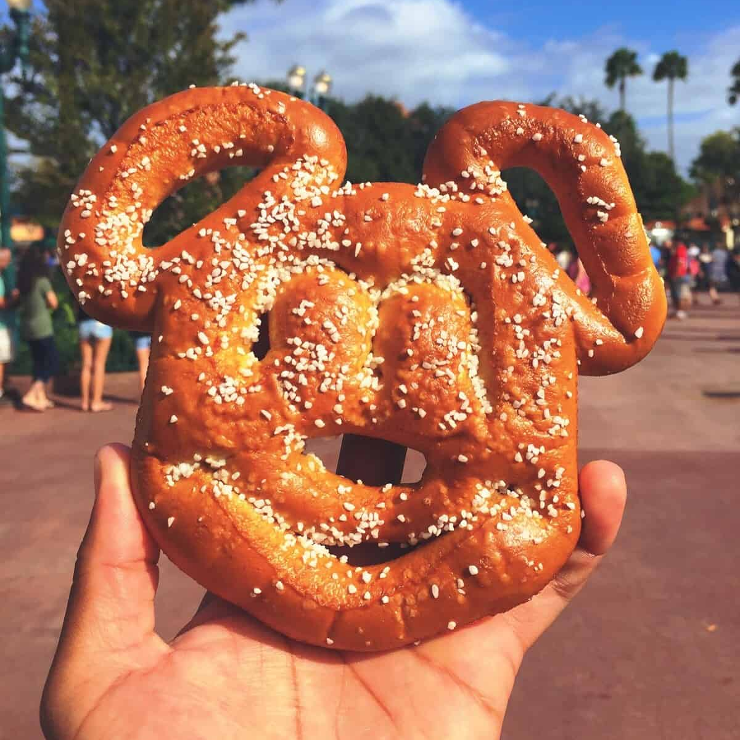
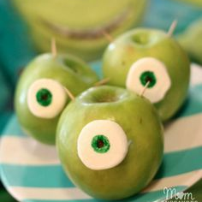

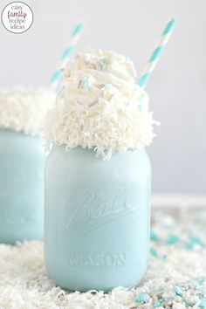
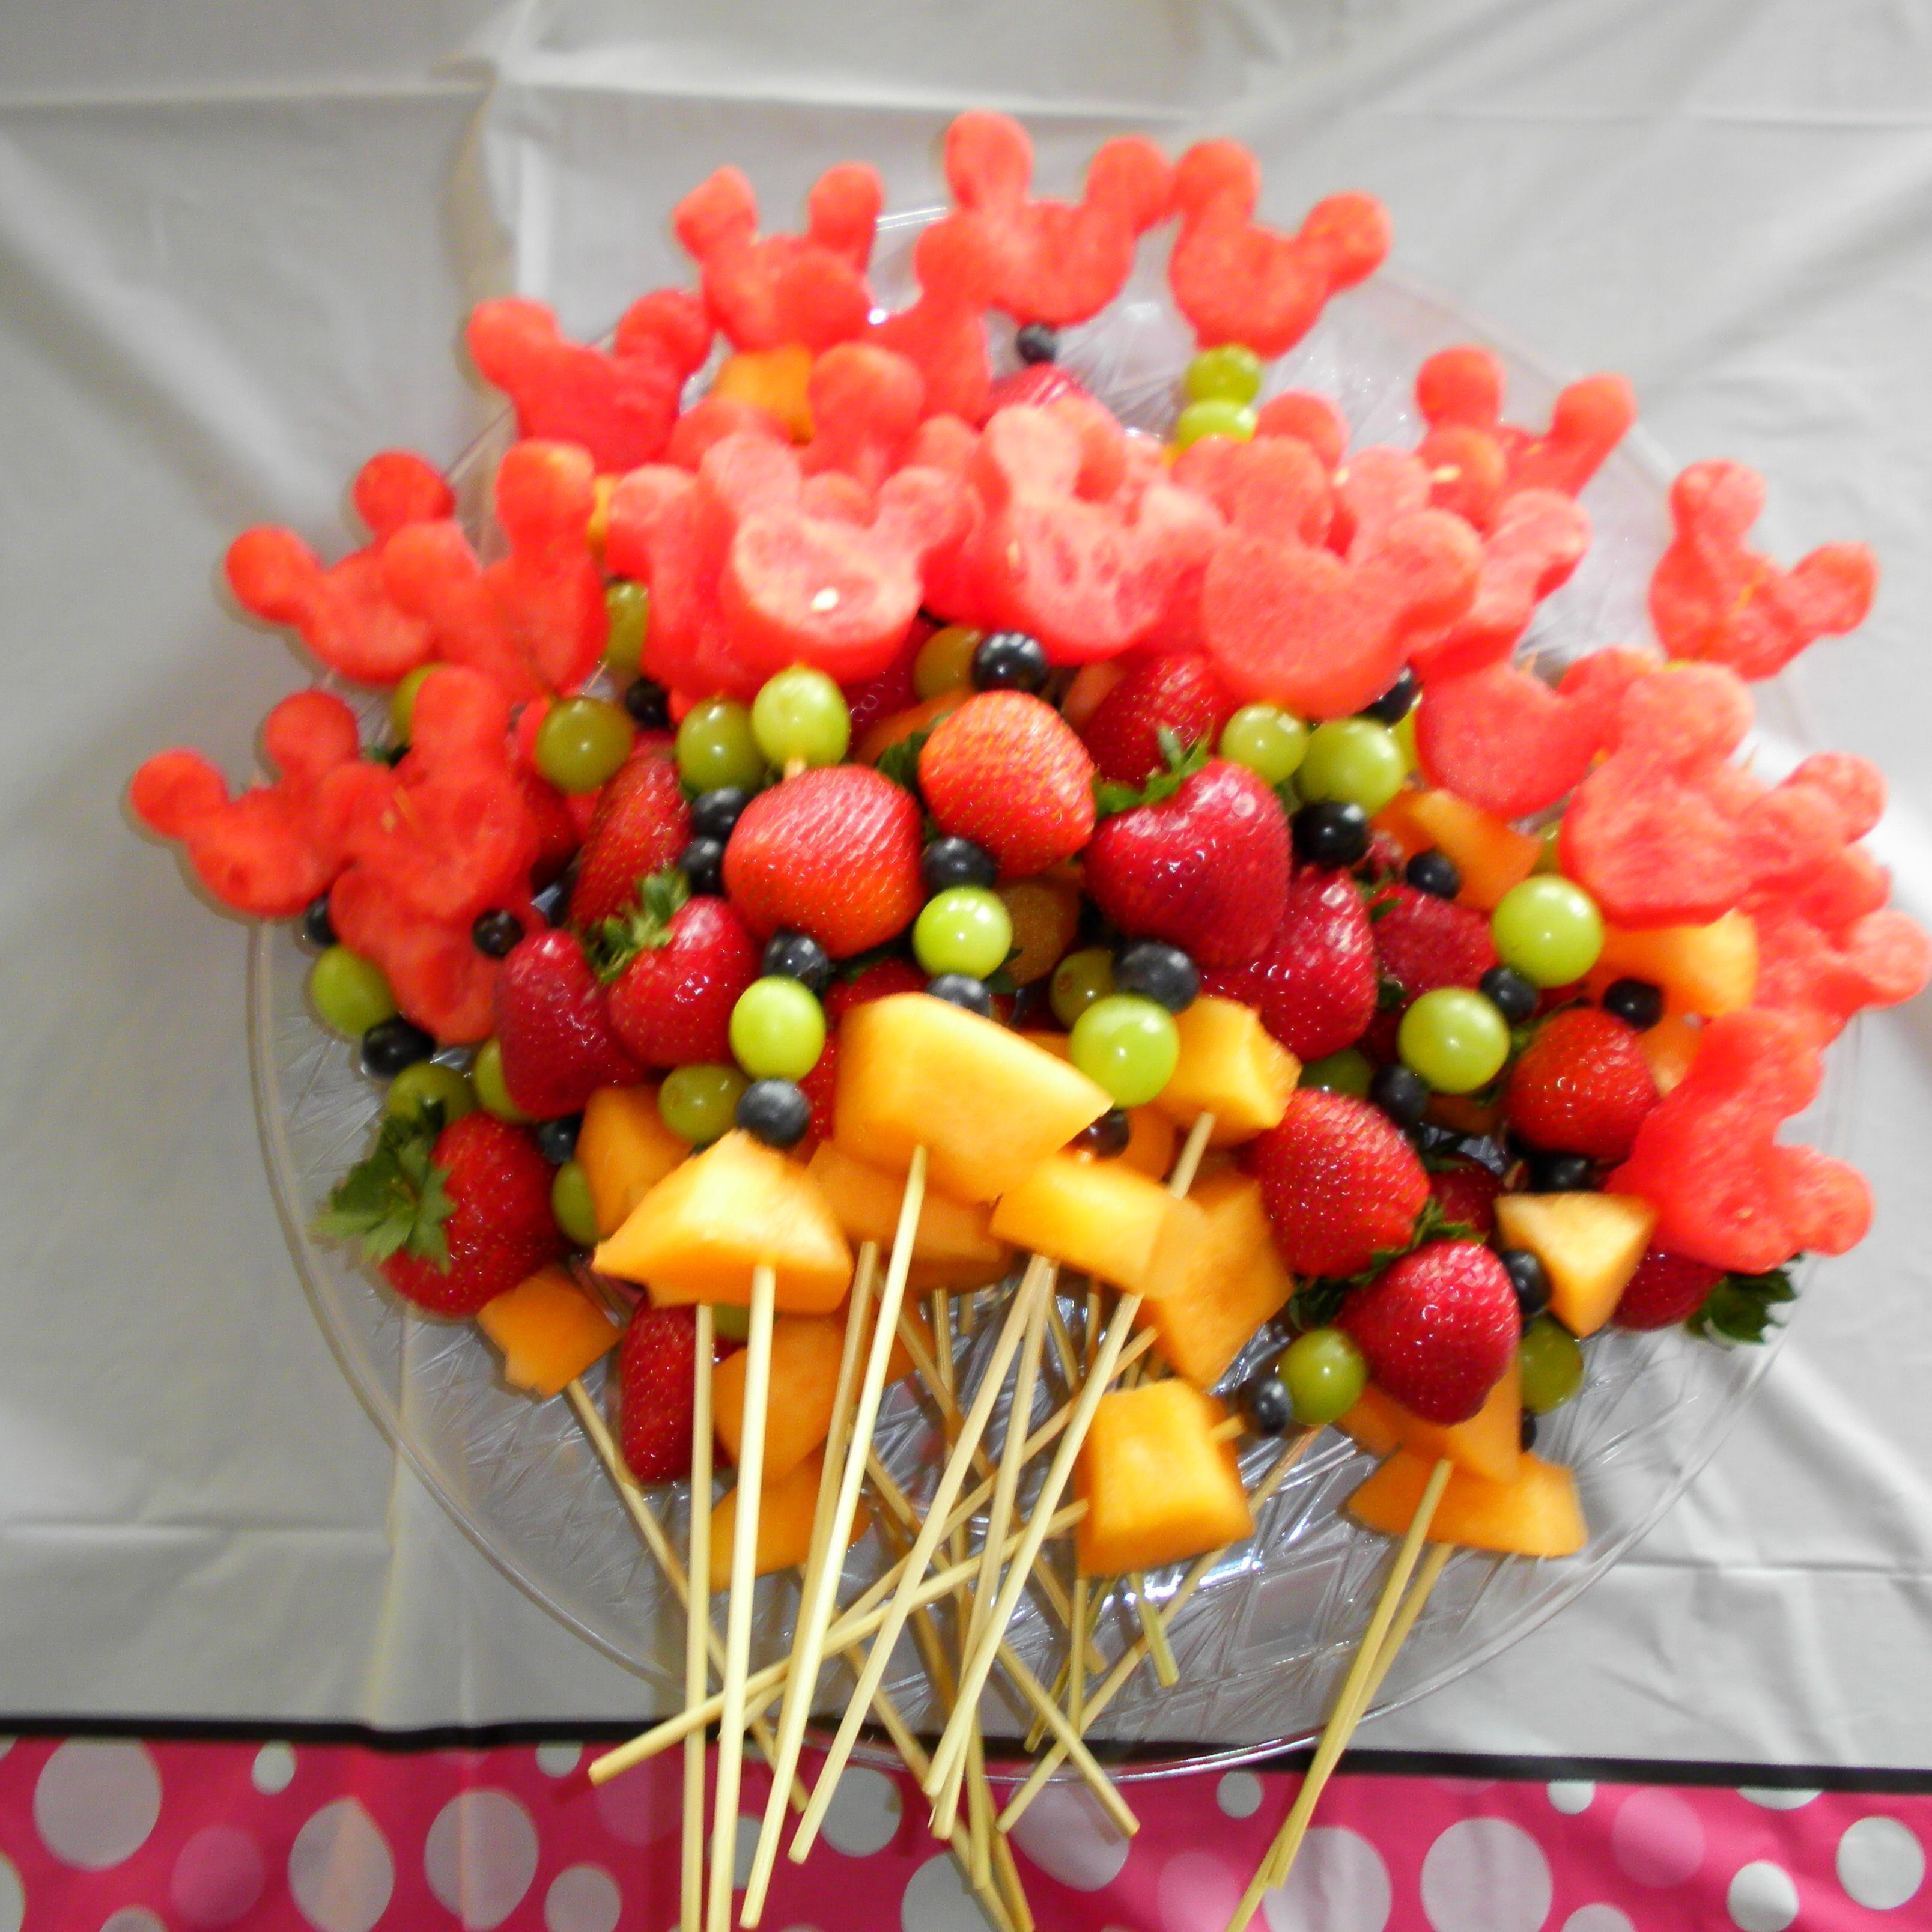
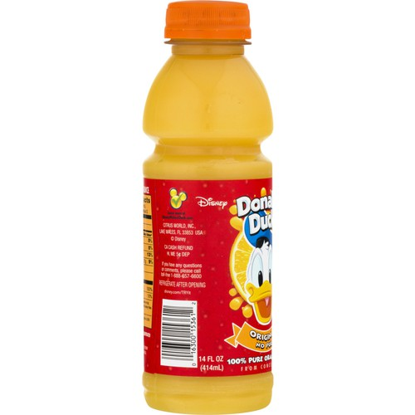
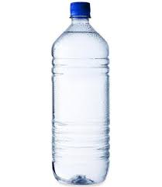
Numeracy: Lunch Time!
You have £10.00 to spend on your lunch.
What will you buy?
Do you have enough money?
How much change will you get?
Cheeseburger £6.00
Pizza
£5.50
Hotdog
£3.50
Chicken & Rice
£7.25
Soup & Bread
£3.50
Pretzel
£2.50
Fruit Kebab
£1.25
Apple
50p
Crisps
70p
Orange Juice
£1.50
Water
£1.00
Frozen Milkshake
£2.50

Slide 15

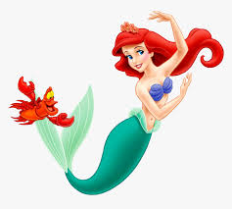
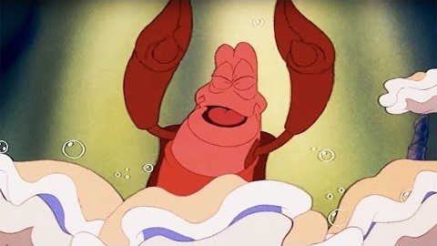
Under the Sea
Listen to:
The Little Mermaid - Under the Sea
Task:
Why does Sebastian think it is better to live under the sea? Give 2 reasons!
Do you agree?
Why or why not?

Slide 16

Thursday: Day 4
Explore the park
Become the Common Word King
Create a new ride

Slide 17
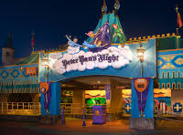
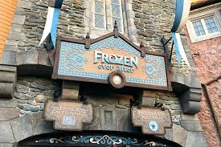
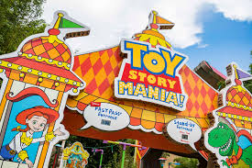
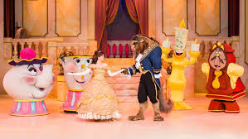
Numeracy: Ride Time!
How long altogether would it take to ride Peter Pan’s Flight & Frozen Ever After?
You have 35 minutes left in the park. Which 2 rides could you go on to make the most of your time left?
How much longer is Toy Story Mania! than Peter Pan’s Flight?
How much shorter is Frozen Ever After than Beauty & the Beast show?
You want to visit all 4 attractions. How long will it take altogether?
Peter Pan’s Flight
Duration: 3 minutes
Frozen Ever After
Duration: 5 minutes
Toy Story Mania!
Duration: 8 minutes
Beauty & the Beast Show
Duration: 30 minutes

Slide 18
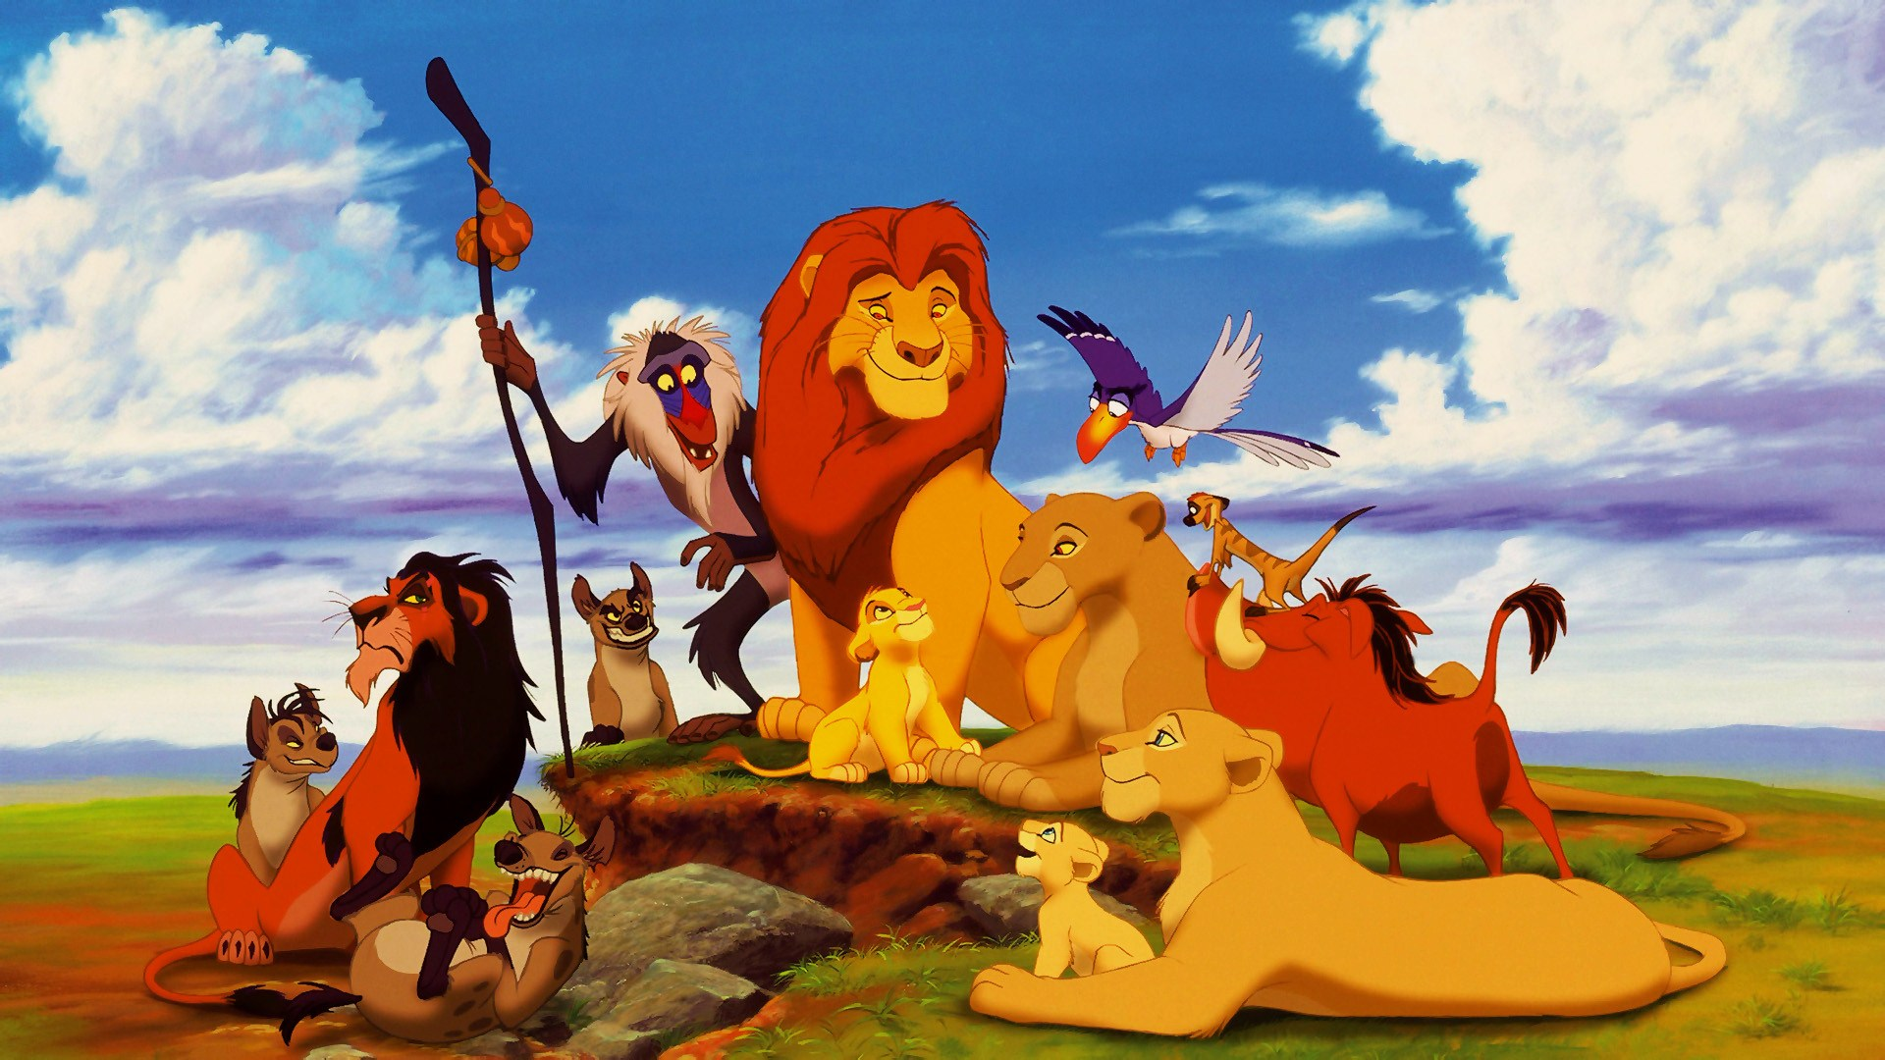
The Common Word King
said
would
Find all 15 of the hidden words to become the Common Word King.
where
here
what
many
the
you
were
does
when
they
of
why
are
come

Slide 19

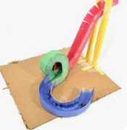




A New Ride: Part 1
The year 2021 is Disneyland’s 50th Anniversary!
We’ve been asked to help design a new ride.
Think about:
What will it be named?
What movie is it based on?
Who will it be for? Young children, teenagers, adults?
What will it look like?
Design your ride! You can draw or build this, you choose.

Slide 20

A New Ride: Part 2
Create a poster to advertise your new ride.
Remember to include: Price, height limits and any safety rules.

Slide 21

Friday: Day 5

Slide 22

Writing: Monsters Inc.
It’s time to enter Monstropolis, the city of Monsters!
Tasks:
Design a monster.
Name your monster.
Describe your monster using 6 adjectives.
Write a story with your monster as the main character.

Slide 23

HWB: Inside Out
Tell an adult something that makes you feel each of these emotions.
Example: I feel sad when my friends don’t share with me.

Slide 24





Disney Parade!
Create a mask of your favourite Disney (or any other) character.
Parade Time!
Take part in the parade as your favourite character.

Slide 25


Send a Postcard!
It’s our last day at Disney World. Can you write a postcard to tell your grandparents/friend/sister/auntie about your school trip to Disney?
Draw a detailed picture of your favourite moment on one side, and write a descriptive message on the back. Remember to include the address you are sending it to too!

Slide 26


I hope you all enjoyed your trip to Disney World!
Big hugs,
Mrs Souter
x

