Slide 1
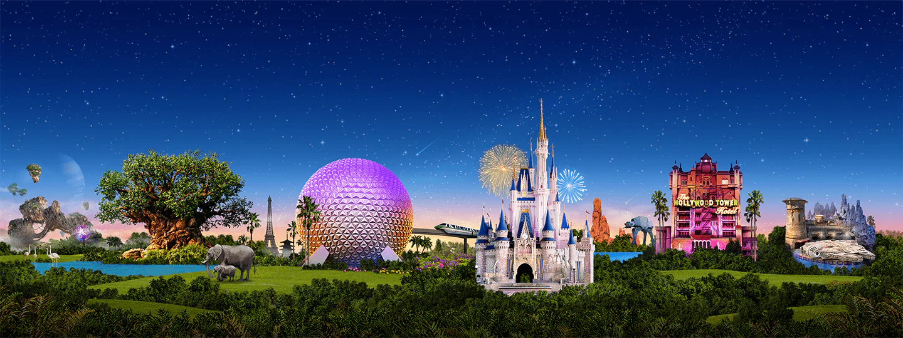
Virtual Disney Trip
Primary 1, 2/1 and 2

Slide 2
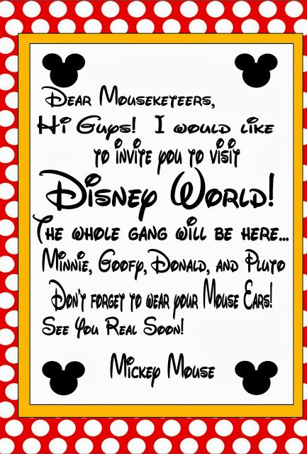
Monday: Day 1
Prepare your passport
Height Check
Donald Duck house boat tour

Slide 3
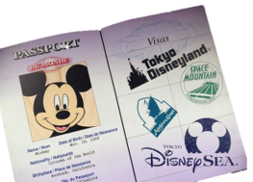
Art
Create a passport that you can use during your trip!
Remember to include:
A front cover
Your name
A picture of yourself
Lots of space for characters names!
Each time you see a character this week in a ride, video or song, make sure to write their name in your passport and draw their picture! How many characters will you meet by the end of the week?

Slide 4
Numeracy: Let’s Ride!
Alien Swirling Saucers:
You must be taller than 6 pieces of cutlery
Do you think you will be taller?
Measure your height.
How many pieces of cutlery tall are you?
Are you able to ride?
Slinky Dog Dash:
Your family member must be taller than 15 blades of grass
Do you think they will be able to ride?
Measure their height.
Are they able to ride?
Ready to ride? Click the rides to go!

Slide 5
Literacy: Donald Duck’s House Boat
Take a tour of Donald Duck’s House Boat. What can you see? Draw and label 5 things you can see inside his house.
Can you think of a story using Donald Duck’s house boat as the setting?
Write about how Donald Duck’s house boat is different from yours. For example, my windows are not circles and I don’t dry my washing on my roof!
Challenge!

Slide 6
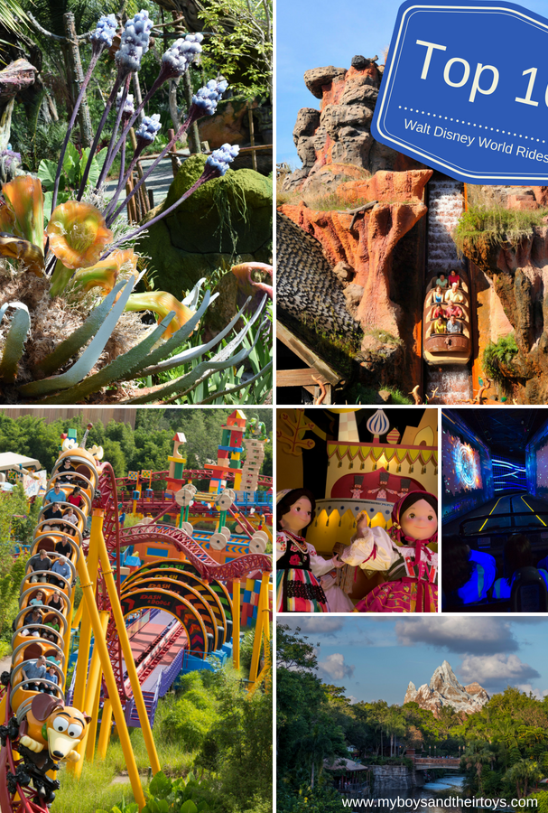
Tuesday: Day 2
Safety
Maps
Timings

Slide 7
HWB: Safety around the park
Watch the video below of Disneyland. Can you think of any rules or things you could do to keep safe at the park? Think about what you should do on rides, who you would speak to and any extra rules you can think of.

Slide 8
Numeracy: Exploring
Look at the map of Disneyland. Can you find your way through the map?
Start at the entrance and go to Donald Duck’s Boat
Start and the log flume and go to the rollercoaster
Start at the pond and go to the Frozen ride
Can you give detailed directions of how to get to each place?
Challenge!

Slide 9
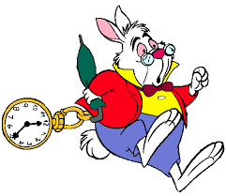
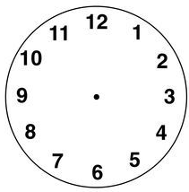
Numeracy: What time?
Draw the hour and minute hands to show the time.
The park opens at 9 o’clock.
You visit Mickey’s house at 11 o’clock.
You go on the log flumes at 4 o’clock.
Challenge!
You visit the arcade at half past 11.
You eat dinner at 6:30pm.
The park closes a thalf past 8.

Slide 10
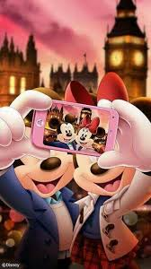
Wednesday: Day 3
Weather
Small World Ride
Under the Sea

Slide 11
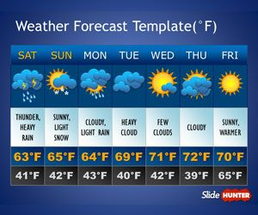
Weather Check
Disneyland is in Orlando in America.
Find out what the weather is like in Orlando this week.
Will it be rainy, cloudy or sunny?
What is the temperature?
Task: Create a weather report video/poster or something else to tell us about the weather at Disney World.
What will we need to pack to be prepared?

Slide 12
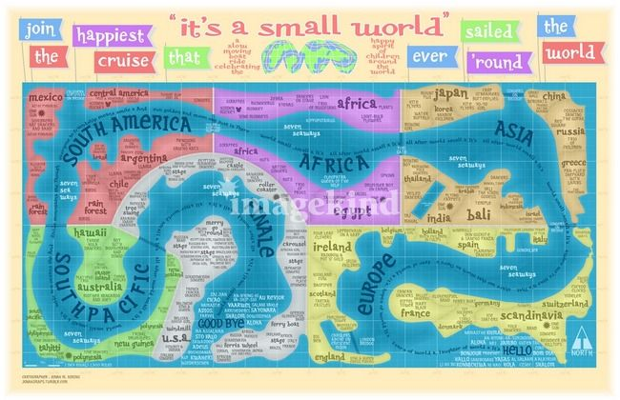
It’s a Small World
Compare Scotland to another country.
You may include:
Location
Weather
Food
Flags
Attractions/scenery
Anything else!
You can create a poster or record a video to showcase your information.
Set sail on the, ‘It’s a Small World’ Boat Ride to visit countries around the world. (Click the picture to go!)
Then choose one activity to complete.
Find out 2 facts about another country. You could add pictures, drawings and words to display this.
OR

Slide 13
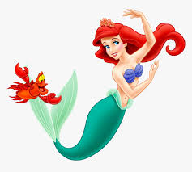
Under the Sea
Listen to:
The Little Mermaid - Under the Sea
Task:
Why does Sebastian think it is better to live under the sea? Give 2 reasons!
Do you agree?
Why or why not?

Slide 14
Thursday: Day 4
Buying snacks
Making snacks with Ratatouille
Postcard

Slide 15
Numeracy - Snack Time
Here is a snack menu from Disneyland. Choose the snack you would like and the correct coins to pay for it. CHALLENGE – how much change would you get if you only had a 10p to pay with?
Challenge!
How many ice creams could you get for 50p?

Slide 16
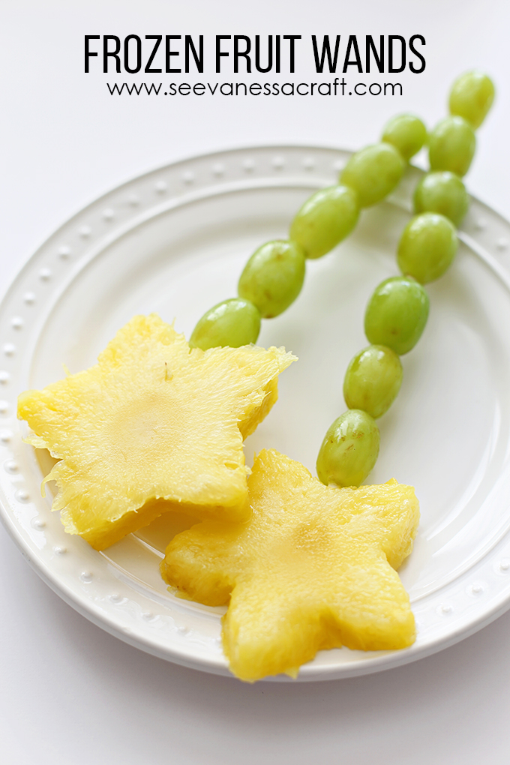
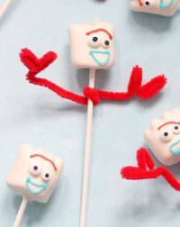
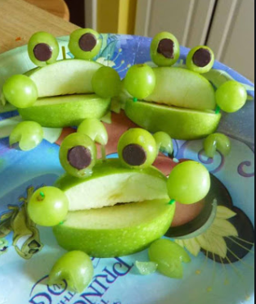
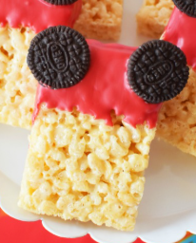
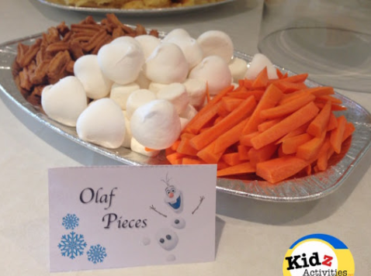
HWB – Making Snacks
Some simple snack ideas
Watch the clip from Ratatouille. Can you help to prepare a healthy snack today? Follow a recipe if you can!
Take a photo and show us your home made snacks!

Slide 17
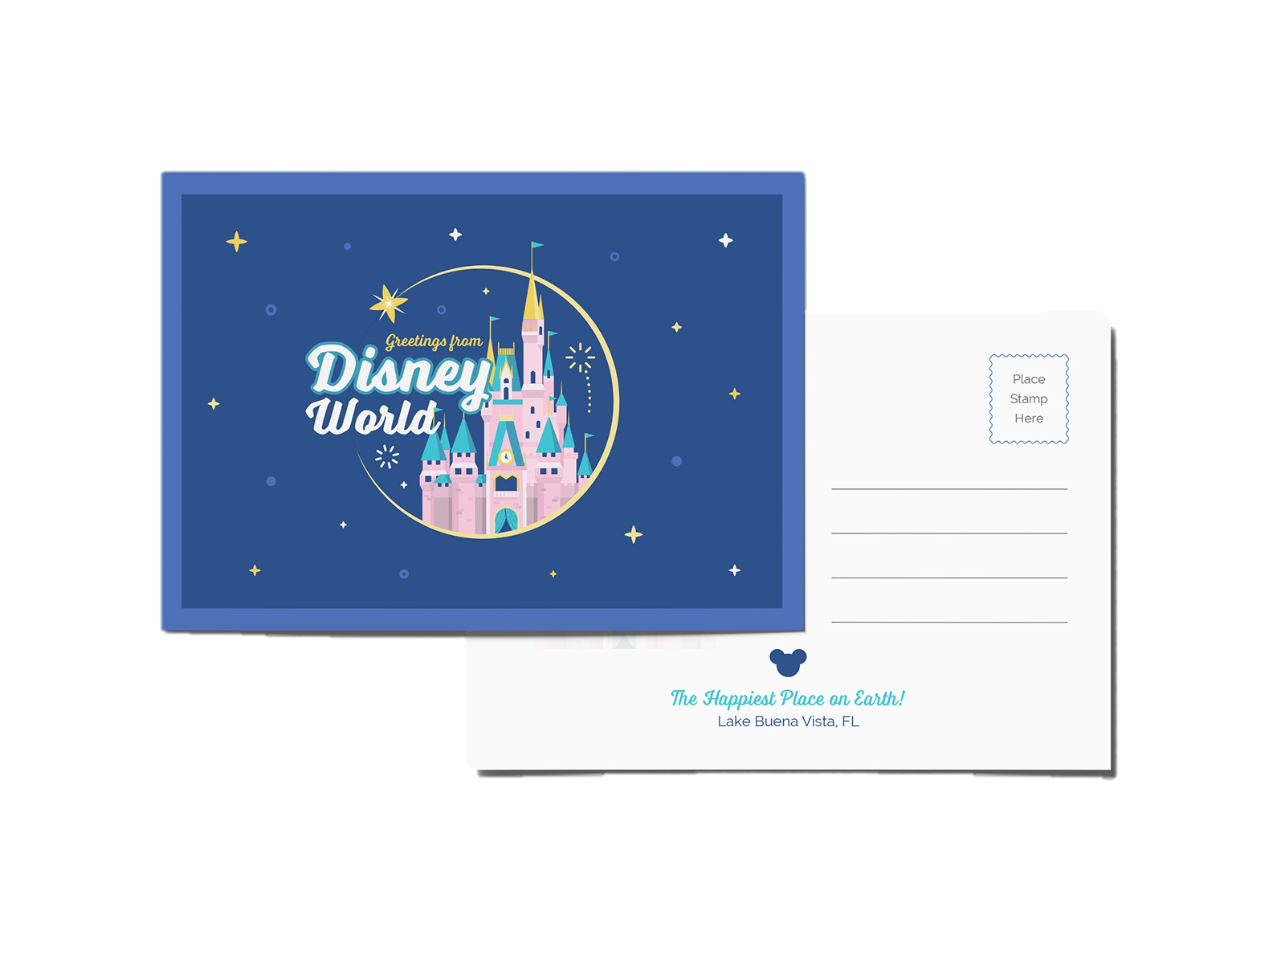
Send a Postcard!
Tomorrow is our last day at Disney World. Can you write a postcard to tell your grandparents/friend/sister/uncle about your school trip to Disney?
Draw a detailed picture of your favourite moment on one side, and write a descriptive message on the back. Remember to include the address you are sending it to too!

Slide 18
Friday: Day 5
Create a new ride
Inside Out Feelings
Souvenir photo
Parade

Slide 19
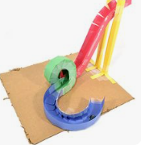
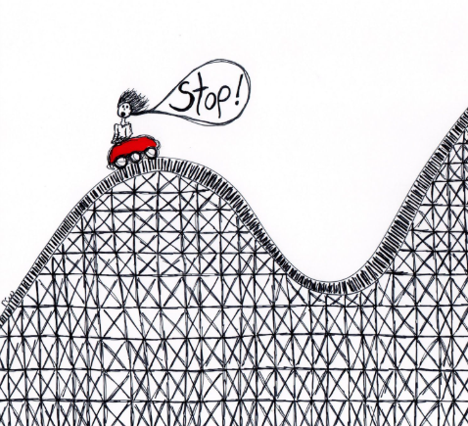
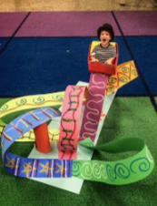
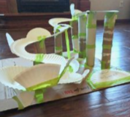
A New Ride: Part 1
The year 2021 is Disneyland’s 50th Anniversary!
We’ve been asked to help design a new ride.
Think about:
What will it be named?
What movie is it based on?
Who will it be for? Young children, teenagers, adults?
What will it look like?
Design your ride! You can draw or build this, you choose.

Slide 20
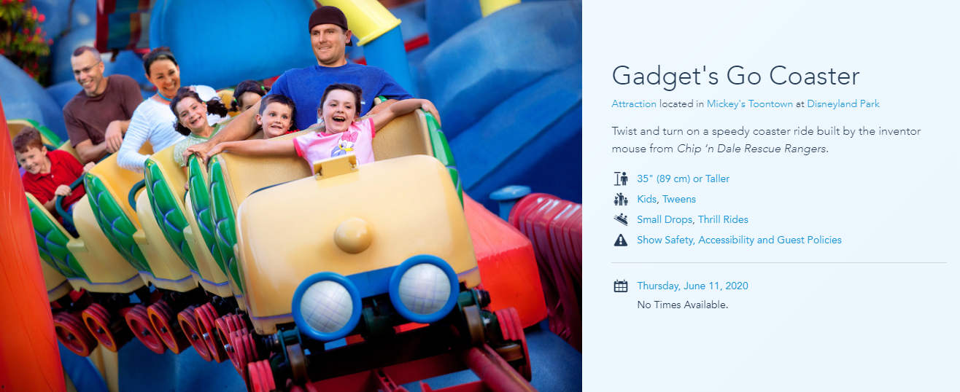
A New Ride: Part 2
Create a poster to advertise your new ride.
Remember to include: Price, height limits and any safety rules.

Slide 21
HWB: Inside Out
Tell an adult something that makes you feel each of these emotions.
Example: I feel sad when my friends don’t share with me.

Slide 22
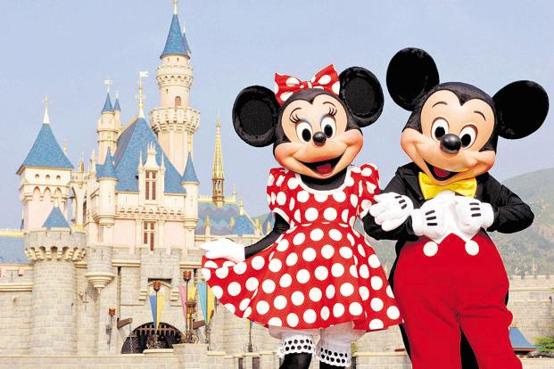
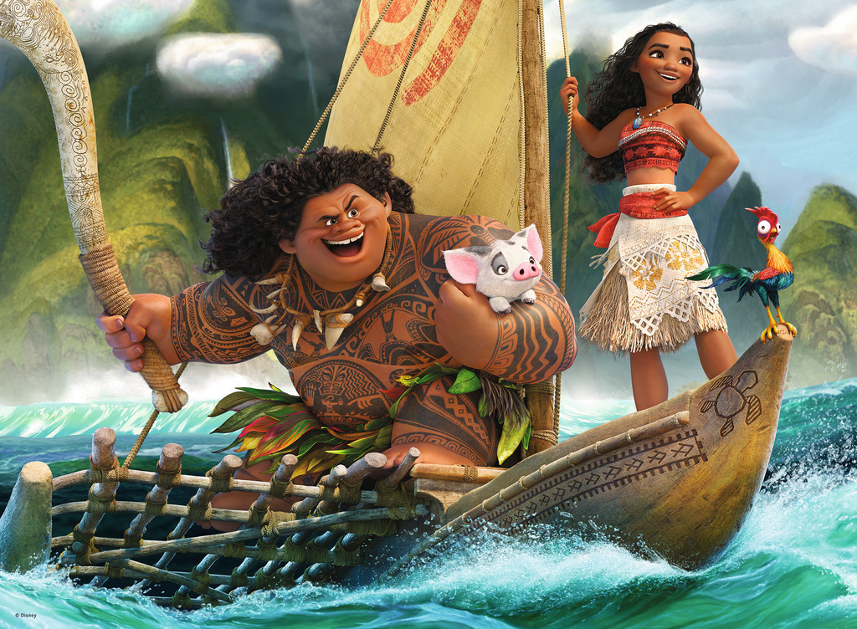
Take a Selfie
Add a photo of your face to the pictures to create your own Disney selfie.

Slide 23
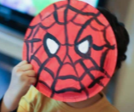
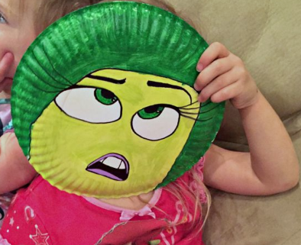
Disney Parade!
Create a mask of your favourite Disney (or any other) character.
Parade Time!
Take part in the parade as your favourite character or just try to dance along.

Slide 24
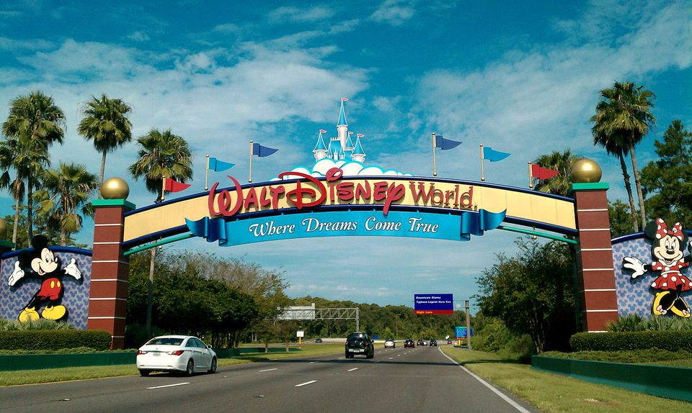
I hope you all enjoyed your trip to Disney World!
Big hugs, Miss Brewster, Miss Barr and Miss Wilson
x

