Slide 1

P4 Numeracy Activity
Learning Intention: I am learning to use a range of subtraction strategies to find an answer. MNU 1-03a
Success Criteria:
  I can pick a strategy.
  I can accurately answer a sum.
  I can read an answer to see if it makes sense.

Slide 2
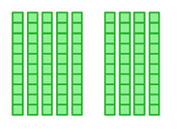
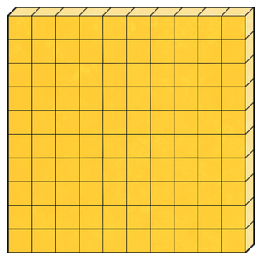
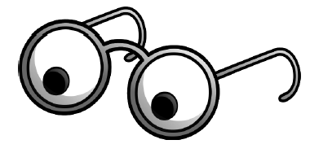
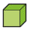
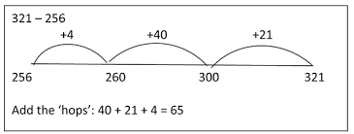
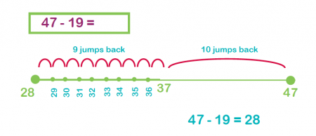
Subtraction Strategies
Notes:
There are many different subtraction strategies including using concrete materials, number lines to count/jump on and back.

Slide 3
Partition or split the numbers into parts
a)
240
-
60

Slide 4
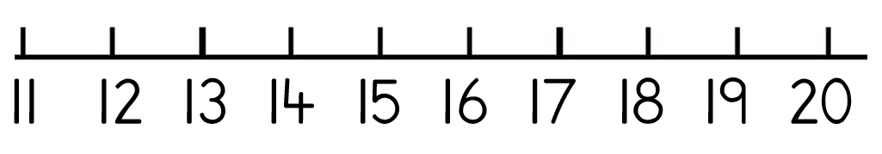

When numbers are close together in a subtraction you can count the hops between them.
20 - 17
Start on 17 and count up 3 hops to 20.
Start on 20 and count down 3 hops to 17.
Counting up is a bit easier

Slide 5

Show your working:
Write out the sum to show the parts you took away.
  47 – 19 = 47 – 10 - 9
Show the skips on an empty numberline

Slide 6

There are lots more ways to figure out subtraction answers.
Read each sum carefully
Think about how you could figure out the answer
Take your time with your subtracting
Write or draw anything that helps you keep track
Does your answer make sense? Your subtraction answers should be smaller than the starting number!
Notes:
hftu

